Slide 1
Chapter 9
Differential Equations: Classical Methods
A differential equation (DE) may be defined as an equation involving one or more derivatives of an unknown dependent variable or several variables with respect to one or more independent variable or variables.

Slide 2
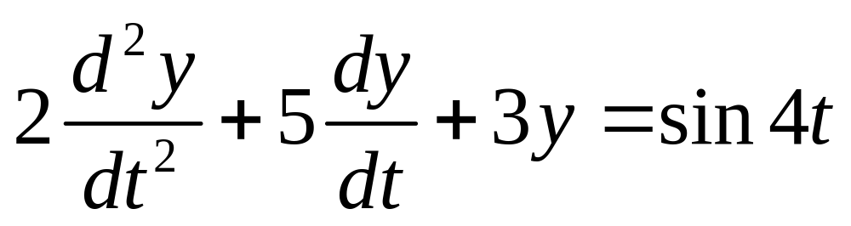
Linear DE versus Non-Linear DE
A linear differential equation is one in which the dependent variable and its derivatives with respect to the independent variable are of the first degree and all multiplicative factors are either constants or functions of the independent variable. An example follows.

Slide 3
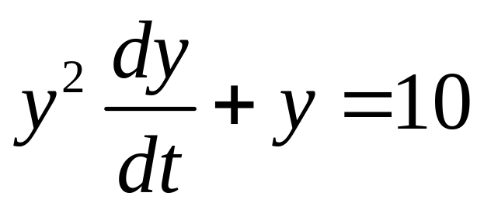
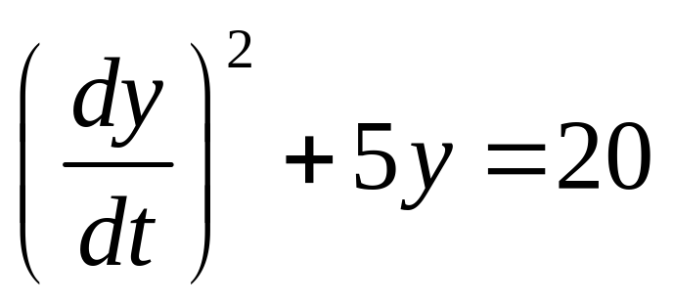
Two Examples of Non-Linear Differential Equations

Slide 4
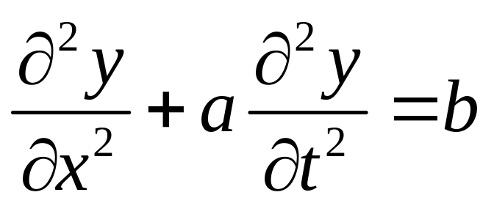
Ordinary DE versus Partial DE
The preceding equations have been ordinary types since the dependent variable was a function of only one independent variable. An example of a partial differential equation follows.

Slide 5
Continuous-Time versus Discrete-Time
The preceding definitions relate to continuous-time or "analog” systems. However, the same forms may be adapted to discrete-time or "digital" systems. In such cases, the equations are generally known as difference equations. Most numerical methods involve approximating differential equations as difference equations.

Slide 6
Boundary Conditions or
Initial Conditions
The solution of an Nth order DE usually involves N arbitrary constants. These constants are determined from the boundary conditions. When these conditions are specified as the initial value of the function and the first N-1 derivatives, they are called initial conditions.

Slide 7
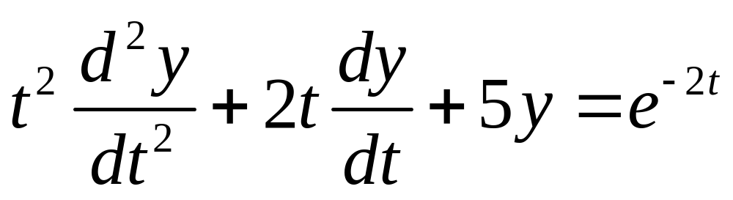
Example 9-1. Classify the following DE in several ways:
The DE is linear since none of the coefficients are functions of y and there are no higher degree terms in y or its derivatives.
The DE is an ordinary type since y is a function only of t.

Slide 8
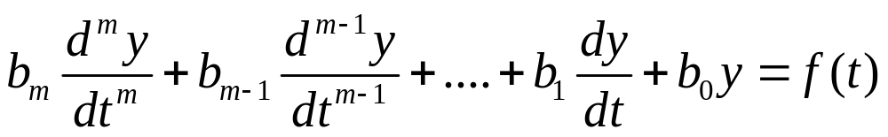
Constant Coefficient Linear Ordinary Differential Equation (CCLODE)

Slide 9
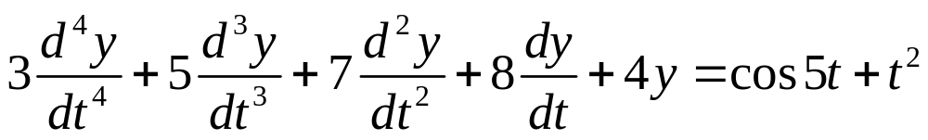
Example 9-2. Classify the DE below.
This DE is a CCLODE type.
It is a 4th order DE.

Slide 10
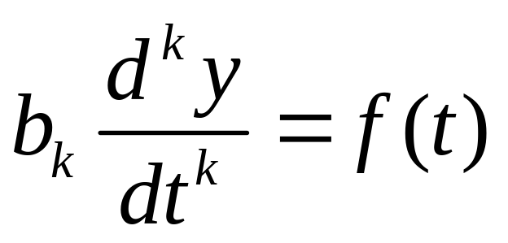
Simple Integrable Forms
In theory, this equation may be solved by integrating both sides k times. It may be convenient to introduce new variables so that only first derivative forms need be integrated at each step.

Slide 11
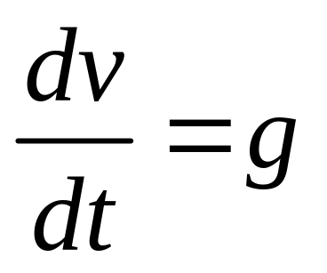
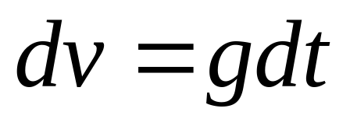
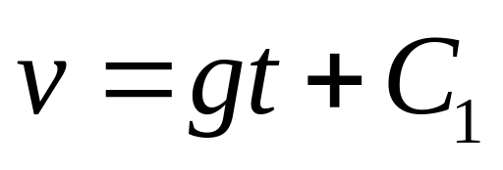
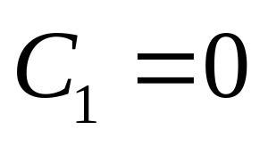
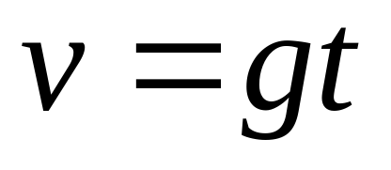
Example 9-3. An object is dropped from a height h at t = 0. Determine velocity v and displacement y.

Slide 12
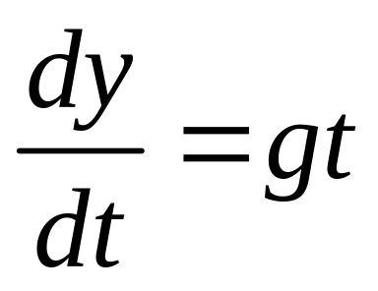
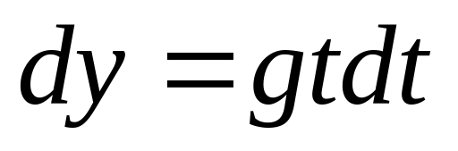
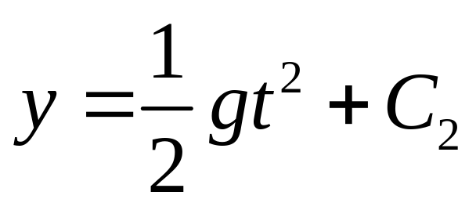
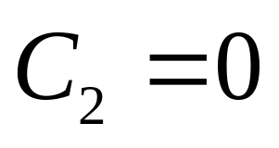
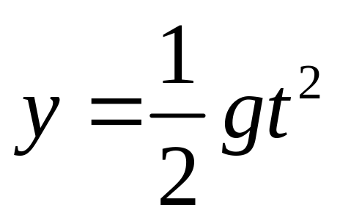
Example 9-3. Continuation.

Slide 13
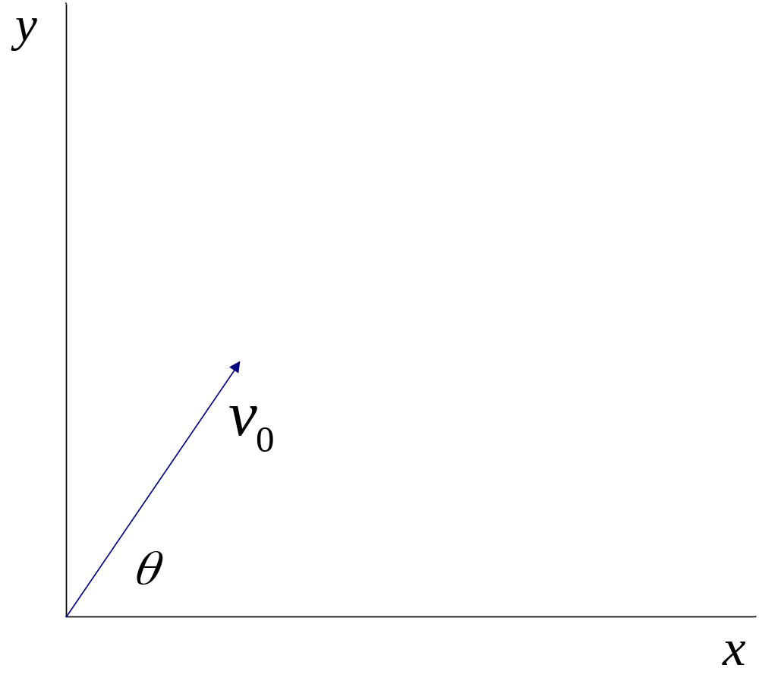
Example 9-4. Consider situation below and solve for velocity and displacement in both x and y directions.

Slide 14
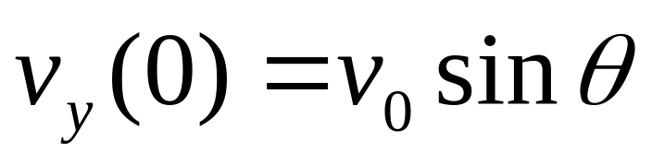
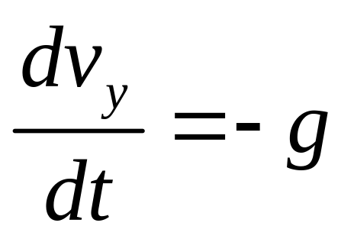
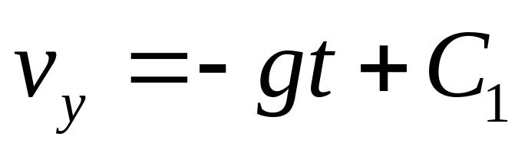
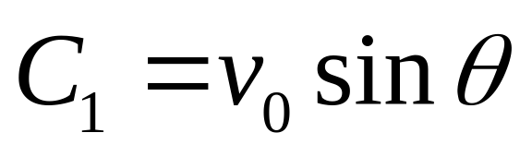
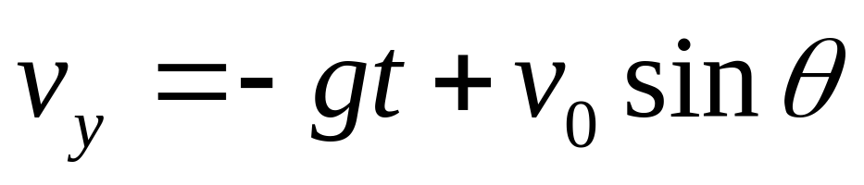
Example 9-4. Continuation.

Slide 15
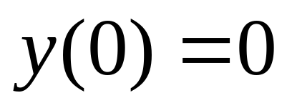
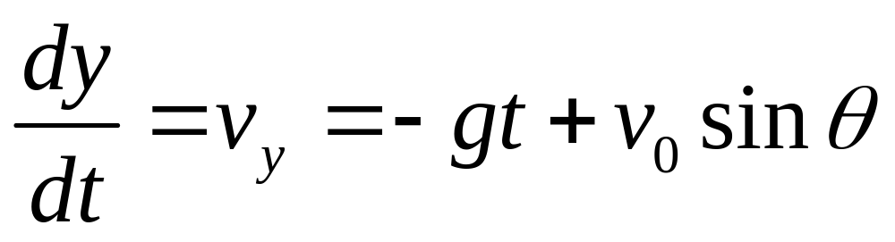
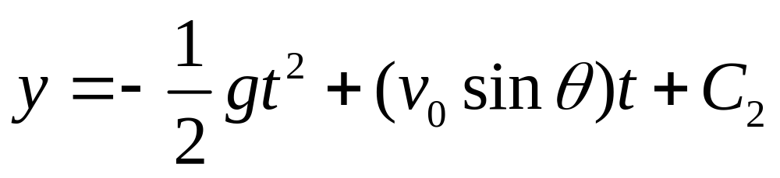

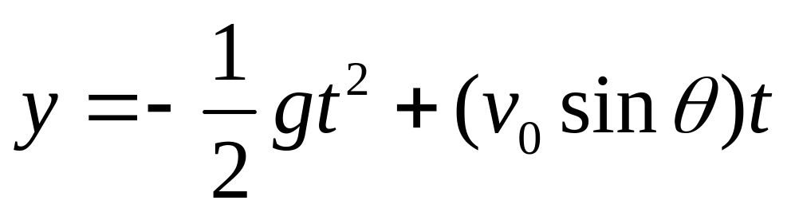
Example 9-4. Continuation.

Slide 16
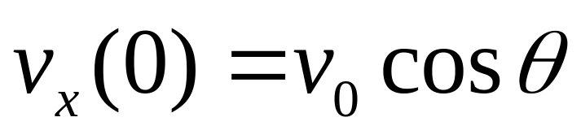
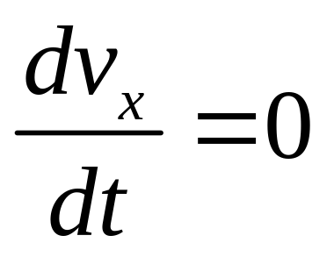
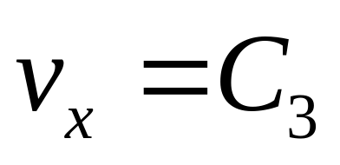
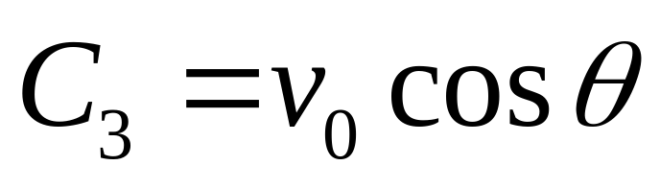
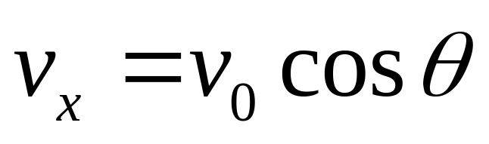
Example 9-4. Continuation.

Slide 17
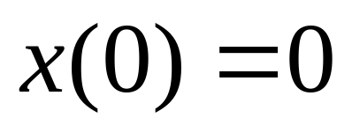
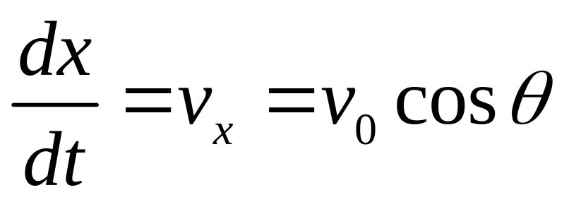
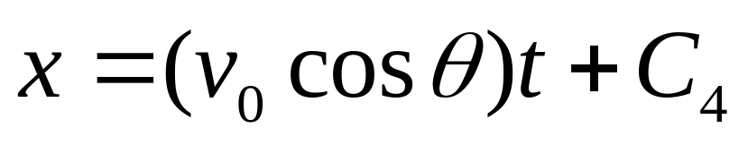
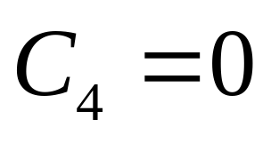
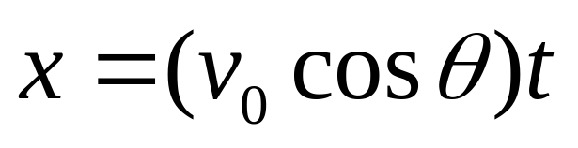
Example 9-4. Continuation.

Slide 18
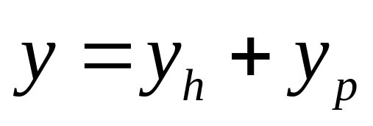
Constant Coefficient Linear Ordinary Differential Equations (CCLODE)
The general solution consists of a homogeneous solution plus a particular solution. The homogeneous solution is also called the complementary solution.

Slide 19
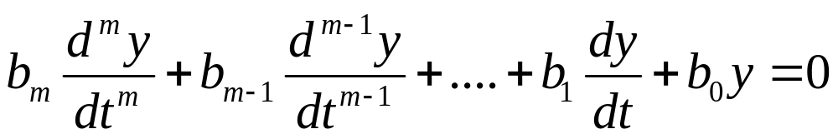
Homogeneous Equation

Slide 20
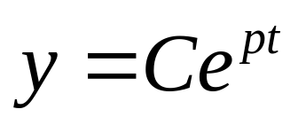
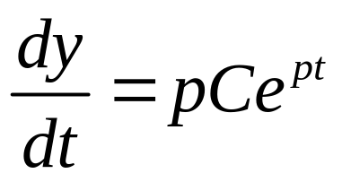
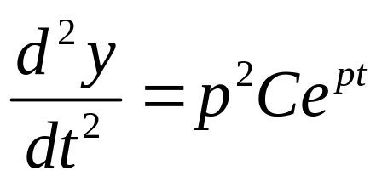
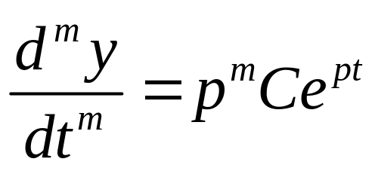
Homogeneous Solution

Slide 21
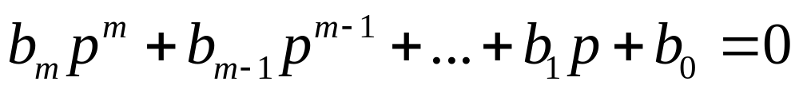
Characteristic Equation
Substitute the form on the previous slide in the DE and cancel the common exponential factor. The result is the characteristic equation shown below.

Slide 22
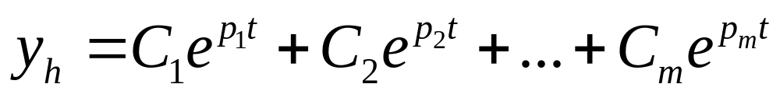
Homogeneous Solution Form
The m roots of the characteristic equation are determined, and the form of the homogeneous solution for non-repeated roots is shown below. Note that if f(t) = 0, this result is the complete solution.

Slide 23
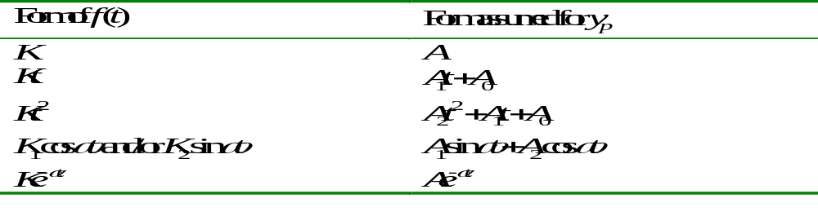
Particular Solution
The particular solution depends on the form of f(t). Assuming non-repeated roots, the table below shows the forms involved.

Slide 24
Combining Particular and Homogeneous Solutions
1. The form of the particular solution is substituted in the DE and its constants are determined.
2. The homogeneous and particular solutions are combined and the arbitrary constants from homogeneous solution are determined from boundary or initial conditions.

Slide 25
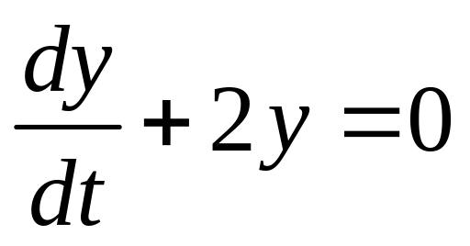
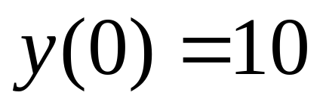
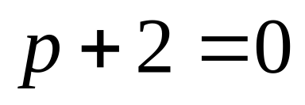




Example 9-5. Solve DE given below.

Slide 26










Example 9-6. Solve DE given below.

Slide 27




Example 9-7. Solve DE given below.

Slide 28




Example 9-7. Continuation.

Slide 29




Example 9-7. Continuation.

Slide 30






Example 9-8. Solve DE given below.

Slide 31





Example 9-8. Continuation.

Slide 32








Example 9-9. Solve DE given below.

Slide 33





Example 9-9. Continuation.

Slide 34
Some General Properties of Systems Described by CCLODEs

Slide 35

Stability
A system is said to be stable if its natural response approaches zero as the time increases without limit. If this condition is met, the system will be stable for any finite forcing response. For a stable system, the terms below are often used.

Slide 36
Classification of Roots of the Characteristic Equation
1. first-order and real
2. first-order and complex (including purely imaginary)
3. multiple-order and real
4. multiple-order and complex (including purely imaginary)

Slide 37






Example 9-10. Investigate properties of DE below.

Slide 38
Example 9-10. Continuation.
The system is stable since both of the terms in the homogeneous solution approach zero as time increases.
Since the system is stable, the natural response is a transient response, and the forced response is a steady-state response.

Slide 39


Second-Order Systems
There are three cases: (1)roots are real and different, (2) roots are real and equal, and (3) roots are complex (including purely imaginary).

Slide 40



Three Forms for Stable Systems

Slide 41
Relative Damping
1. If the roots are real and unequal, the system is said to be overdamped.
2. If the roots are real and equal, the system is said to be critically damped.
3. If the roots are complex, the system is said to be underdamped.
4. A special case of an underdamped system is when there is no damping. the system is then said to be undamped.

Slide 42





Example 9-11. Solve DE given below.

Slide 43





Example 9-11. Continuation.

Slide 44




Example 9-12. Solve DE given below.`

Slide 45





Example 9-12. Continuation.

